Slide 1
Working with Historical Maps
Ian Holmes
EDINA
Geoservices Support

Slide 2
Introduction
Digital Historical Maps
Online Services
Georeferenced Maps
Why use Digital Maps?
Digimap
Using Online Services for Research
Digital Maps as data
Practical Downloading maps

Slide 3
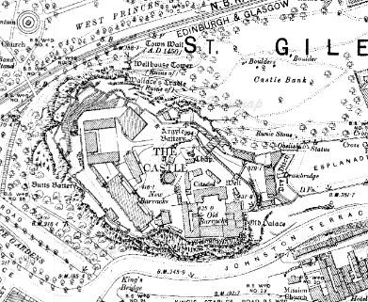
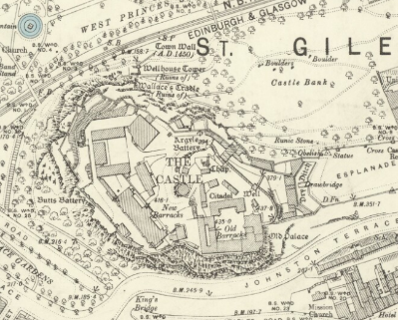
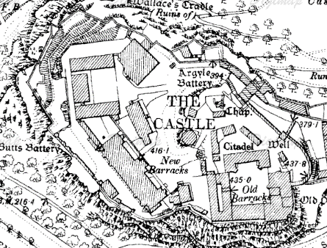
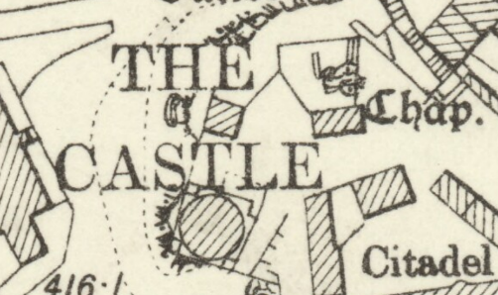
Digital Historical Maps
Notes:
What do we mean by Digital historical maps? Essentially scanned old maps!
Over the last 10 years there has been a huge increase in the quality and quantity of scanned historical maps and with improvements the availability of high speed internet access we have never had better access to high quality historical maps.
Pure black and white lower resolution
Full Colour and very high resolution

Slide 4
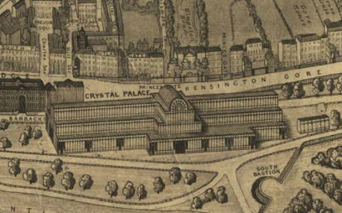
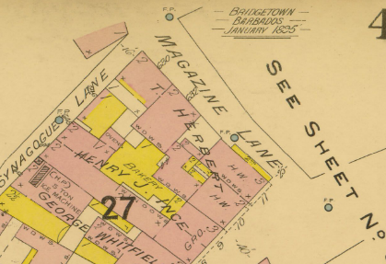
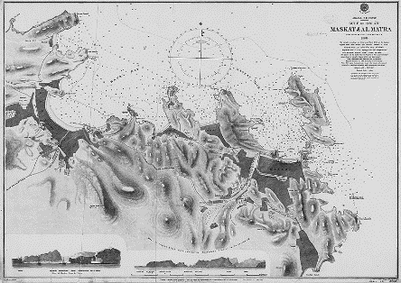
Online Services
British Library: https://www.bl.uk/collection-guides/digital-mapping
4.5 million maps, many of which have been scanned, a portion of which are online:
Notes:
Along with the huge changes to the internet the improvements in computing power and reducing costs, particularly of storage, has meant that large collections of maps have been made available online.
British Library have a huge number of maps many of which have been scanned and a portion of which have been made available online.
There is a vast range of different sorts of maps from a range of places and different scales.
Perspective views, Fire insurance maps of Bridgetown Barbados, Gulf of Oman

Slide 5
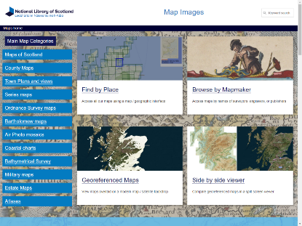
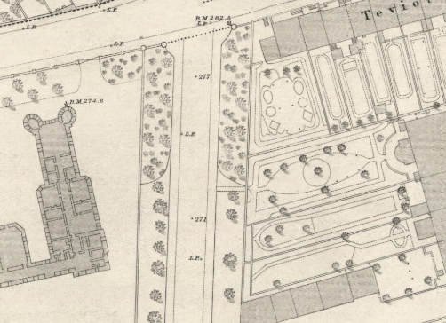
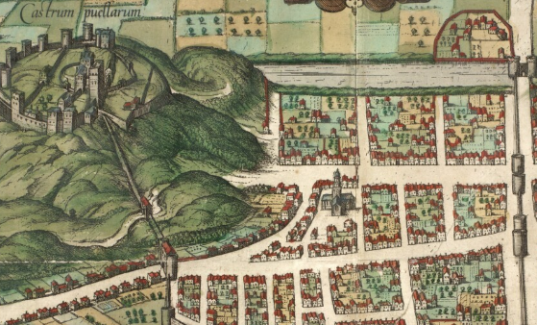
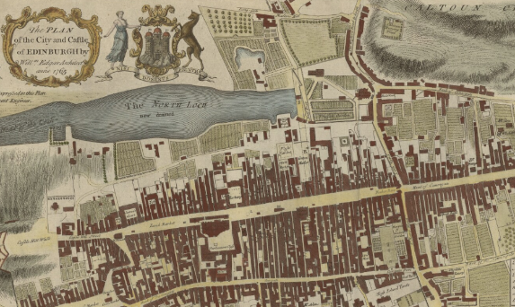
Online Services
National Library of Scotland http://maps.nls.uk/
Notes:
The National Library of Scotland again has a huge collection with a much more accessible interface and a better commitment to making their resources available. Again a broad range of dates and scales are available.
Georg Braun 1540, Plan of the city of Edinburgh and castle Edgar William 1765, Ordnance Survey Town Plan 1877

Slide 6
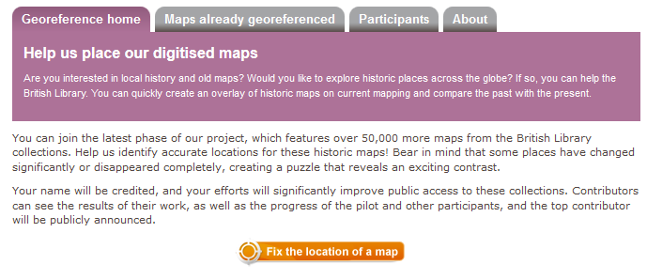
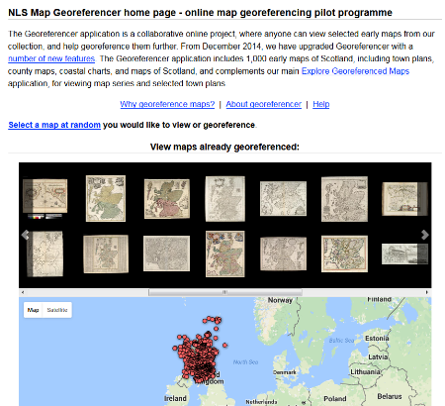
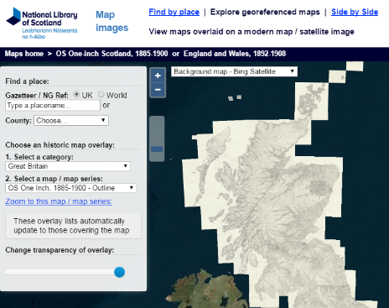
Georeferenced Maps
Notes:
A lot of the more recent work has concentrated on Georeferencing the scanned maps, often through crowd sourcing project such as the one by the British Library.
NLS also ran a crowd sourcing georeferencing project focussed on Scotland from 2011-2017.
Once georeferenced you can start to build up continuous coverages like this one for Scotland.

Slide 7
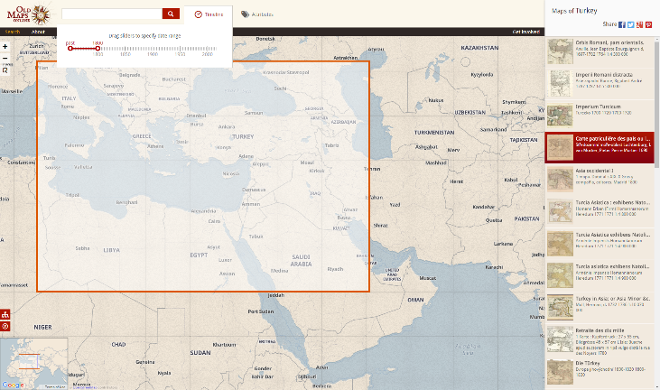
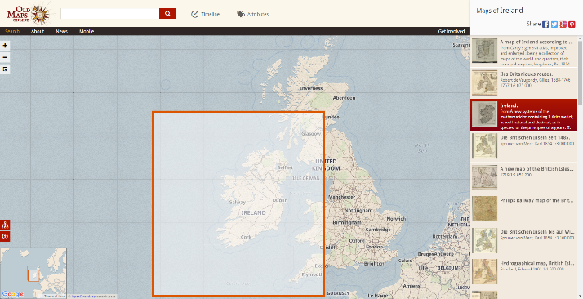
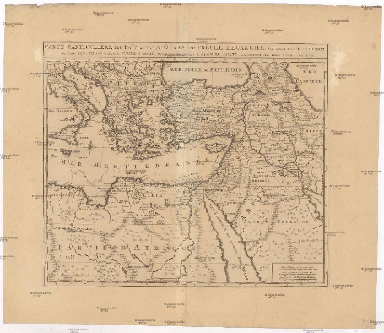
Georeferenced Maps
Notes:
The ability to search mapping catalogues spatially, and temporarily if the date metadata is in place, has allowed portals such as Old Maps online to be created. These are great resources!
A georeferenced map is also important as it can then be used to compare to other maps, to collect data for use with other datasets or in spatial analysis; identifying clusters or other spatial relationships.

Slide 8
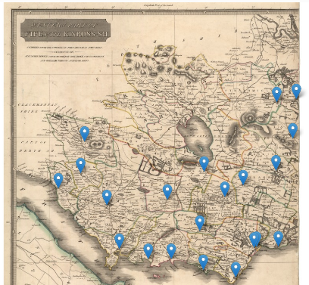
Why use Digital Maps?
Case Studies
Statistical Accounts of Scotland
Notes:
Maps are a great way to engage with data, they are familiar, provide extra context and are designed to allow people to navigate so why not around data.
It also helps you make relationships that may not be apparent from the data, if you are looking for ancestors in one parish you might look at a map and think… I might just check the neighbouring ones too, just in case!

Slide 9
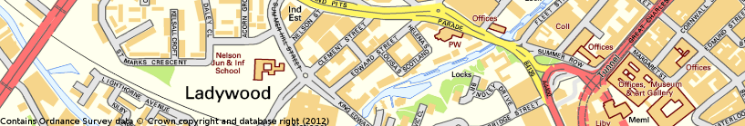
Why use Digital Maps?
Case Studies
Edward Street, Ladywood
Used contemporary maps to chart the history of one street from 1801 to 1911.
Combined maps with data from census returns
Notes:
University of Birmingham, Masters in West Midlands History coursework.

Slide 10
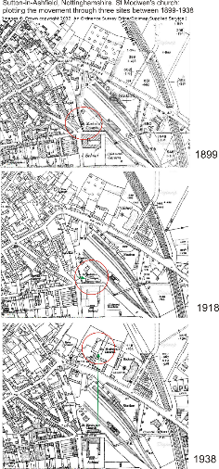
Why use Digital Maps?
Case Studies
Southwell & Nottingham Church History
Historic mapping used to better understand:
How buildings have changed in form over time
How churchyards have changed in shape
How churchyards were used in the past
The former land use of sites of churches
How some churches were moved
The location of previously ‘unknown’ churches (e.g. short-lived mission chapels)
Notes:
University of Nottingham, Research in the Department of History

Slide 11
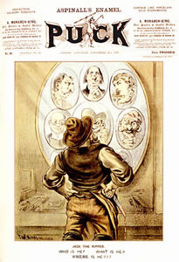
Why use Digital Maps?
Case Studies
Jack the Ripper
Used contemporary mapping (1888 – 1891) to try establish:
Whether all the murders which occurred in the Whitechapel area of London during this period were the work of one killer only.
If any of the suspects actually resided in a suitable location to commit the crime.
Where the real killer lived.
Notes:
Postgraduate workshop University of Sheffield.

Slide 12

Digimap
View, Annotate and Print Maps
UK Mapping Service with several Collections of Data:
Ordnance Survey
Historical Ordnance Survey
British Geological Survey
Hydrographic Office Charts and Marine Data from OceanWise
Land-use data from Centre for Hydrology and Ecology
Aerial Photography from Getmapping
Lidar data from English, Welsh and Scottish environment agencies for 3D landscapes
Global data from OpenStreetMap and Natural Earth
Census data from 2011 Censuses of Population
Notes:
Digimap offers data from a wide range of suppliers but it is much more than an online map viewer.
You can also annotate the maps, highlight features from one dataset and seeing how they correlate to others.
E.G. We noticed that on some old maps there are a few lakes around Edinburgh and comparing them with modern maps you can see they have disappeared.
When we look at the Geological Data, in the Superficial Deposits layer which gives us the environment that the soil was created in we can see a much more accurate picture of the extent of these lakes than is available from the old maps.

Slide 13
Digital Maps as Data
Digimap also allows you to download all its spatial data for use in GIS Software.
Why Download?
Data collection
Combining or layering different information
Spatial Analysis
3D rendering
Notes:
We’ll look a the process of getting data but putting it into a GIS will come later.

Slide 14
Exercise 1: Historic Roam

Slide 15
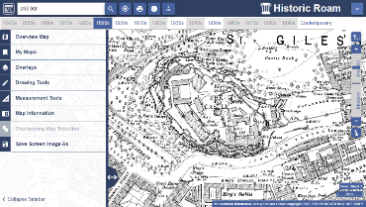

Historic Roam
Find your house!
Login to Digimap, start Historic Roam. See how the area around your house has changed over the last 150 years.
List the major changes:
1.
2.
3.
Map images:© Crown Copyright and Landmark Information Group Limited (2018). All rights reserved. (1896).
TIPS
How would you…
View maps from different decades for your location?
View 2 maps of the same location side by side?
Select one map, where maps for the same area are overlapping?
Find out the publication date of the map you are viewing?
View, save, annotate and print historic Ordnance Survey maps from 1838 – 1997.
Range of map scales available.

Slide 16
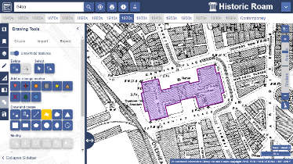


Recreate map of central Liverpool
Login to Digimap, select Historic Digimap → Historic Roam
Search for L3 4AA
Select 1920s from the Timeline
Zoom in to Street View 2, centring on Custom House
Select 2-up view – compare 1920s with 1950s
Return to 1-up view (1920s map)
Open the Drawing Tools and select the polygon tool:
Digitise a polygon over Custom House
Select My Maps → Save Map, give your map a name, e.g. ‘Custom House’ and save it
Write down what map series, edition, scale and date you are viewing – click the information button: then click on the map:
* Map series ---------------------------- * Edition ------------------------------
* Scale ------------------------------------ * Date ------------------------------
Finally, open Ordnance Survey → Roam and view your Custom House map (select My Maps → Open)
What is on the site now?

Slide 17
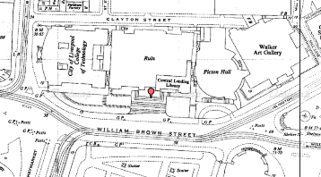
Loading point data in to Roam
Find and double click the file liverpool_WWII_bombs.csv. It should open in Excel. Note the Custom House line has no coordinates – let’s add them
Go back to Historic Roam
Select My Maps → Open and open your Custom House map
Open the Map Information panel
Toggle the Coordinate Capture tool
Move your cursor over the Custom House and click on the map
Copy and paste the British National Grid coordinates: first is Easting, next is Northing
Enter the coordinates in your liverpool_WWII_bombs.csv file, in the Custom House line
Save and close the CSV file
Go back to Historic Roam
Open the Drawing Tools and select Import
Click Choose file, select the CSV file
Click Import, to import the data in to Roam
At the prompt to Replace or Merge your annotations, select Merge
Select X as Easting and Y as Northing
On the Timeline, display a map from 1950s
Zoom in and view some of the markers

Slide 18
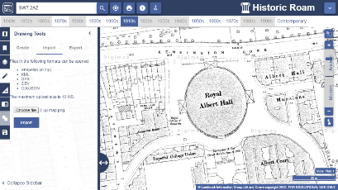
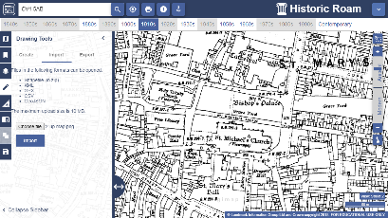
Explore historic maps
Search using SW7 2AZ Zoom into Plan views 1 and 2. What was on the site of Imperial College London (south of the Royal Albert Hall, bordered by Queens Gate on the west and Princes Gate on the east) in the 1870s?
Compare 2 maps of the area around Coventry Cathedral, pre WWII and post WWII. Search using CV1 5AB. Cathedral is marked as St Michael’s Church until 1930s maps. Zoom into Street View 1 and 2.

Slide 19
Exercise 2: Ordnance Survey Roam

Slide 20
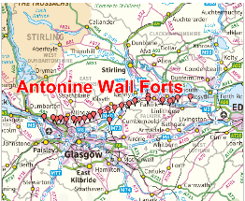
Create a map of the Antonine Wall Forts
What to do:
Try to display the location of Antonine Wall forts on your map by opening a file in Roam:
Open > Import annotations > Browse > select memory stick > antonine wall forts.csv → Import
X = Easting
Y = Northing
Projection = British National Grid
Can you add a label, as shown on the map?
Save your map and annotations, naming it Antonine Wall.
Make an A4 landscape print file. Set the scale at 1:500,000.
Contains OS data © Crown copyright and database right 2018
TIPS
Have a look in Drawing Tools to add labels and symbols to your map.
It’s a good idea to set text size, shape and line colour BEFORE you start drawing.

Slide 21
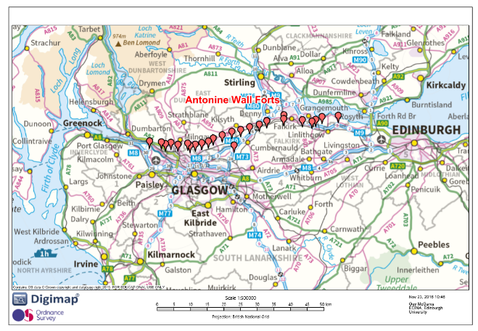
Finished map

Slide 22
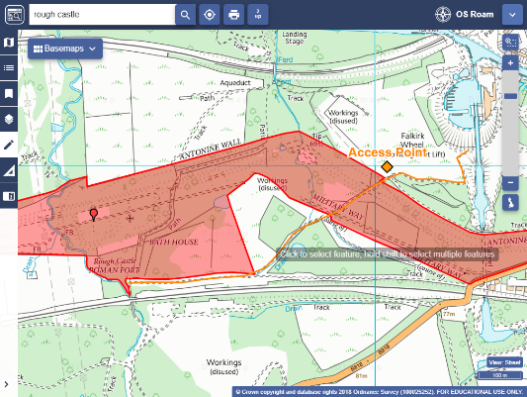
Create a map of the Antonine Wall Forts continued
If you have time…
Zoom in to the fort Rough Castle to the west of Falkirk.
Add an orange path and an orange marker. Label the marker Access point.
Add the Shapefile Antonine_wall_WH1.zip and change the colour of the polygon showing the wall area.
View the wall and sites in Historic Roam against historic OS maps.
Have a look at Historic Environment Scotland portal: http://portal.historicenvironment.scot/spatialdownloads and see what other data you could add.

Slide 23
Exercise 3: Downloading Data

Slide 24
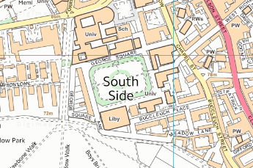
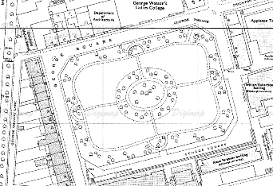
Historic Download
Claire is in the final year of a BA in History
Her undergraduate dissertation topic is looking at the process of urban change in Edinburgh
Claire is in the final year of a BA in Human Geography at Kingston University.
Her undergraduate dissertation topic is looking at the process of urban regeneration for the Olympic Park site in East London.
User requirements:
a map showing the buildings around of George Sq. in 1890’s.
a map showing the buildings around George Sq. in the 1970s
What types of map data would be useful?
Historic OS maps from late 19th Cent.
Historic maps from the 1970’s
Contemporary map of George Square
Your task:
Login to Digimap.
Select Historic > Historic Download
Order these map data products (note: Theme is in the basket)
Draw a rectangle around George Square in Edinburgh
County Series 1:2500 (1853-1951)
1st Edition (1853 – 1904)
National Grid 1:1250 (1943 – 1993)
2nd Revision (1946-1993)
Add To Basket
Select National Grid Tiles for Theme of the 1st Edition
In the basket, name your order George Sq Historic
Request Download
Follow instructions in email to download the data

Slide 25
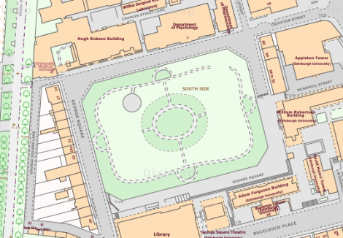
OS Download
Task:
Go into OS Data Download
Go to George Square
Select OS MasterMap 1:2000 Raster (in the Backdrop Mapping section)
Draw a rectangle around George Square
Give the download the name: George Sq MasterMap
Request Download
Follow instructions in email to download the data
Unzip the downloaded files and view in a graphics program e.g. Paint or Photoshop

Slide 26
Exercise 4: Historic Download and QGIS

Slide 27
Download historic map data
Using Historic Download, download the historic map data identified in Exercise 1 showing Custom House in the 1920s
In Historic Roam, Export your drawing features which show the outline of Custom House in Shapefile format.
Your tutor will show you how to view this data in QGIS.

